Slide 1
Assessing the Adoption of Integrated Pest Management Strategies Among Smallholder Tea Farmers in Kiambaa Sub County
Research Project Presentation
Gitonga Cindy Mukami
Jomo Kenyatta University of Agriculture and Technology
8th May 2025

Slide 2
Introduction
- Agriculture is a key sector in Kenya’s economy, contributing significantly to about 21% GDP and employment.
- Tea farming is a major cash crop, supporting millions of livelihoods.
- Pests pose a serious threat to tea production, leading to reduced quantity and quality of yields and economic losses.
- Integrated Pest Management (IPM) is a sustainable alternative to chemical pesticides, but its adoption remains low among smallholder farmers.
- Understanding the factors affecting IPM adoption is crucial for improving tea farming practices.

Slide 3
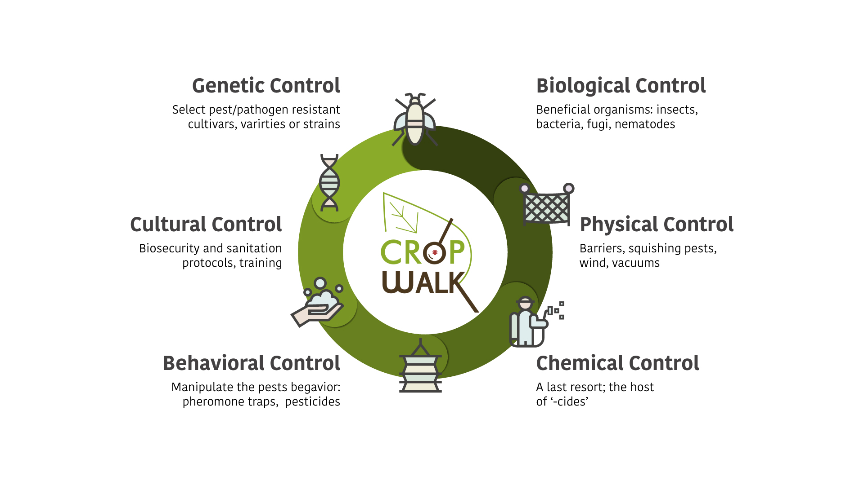
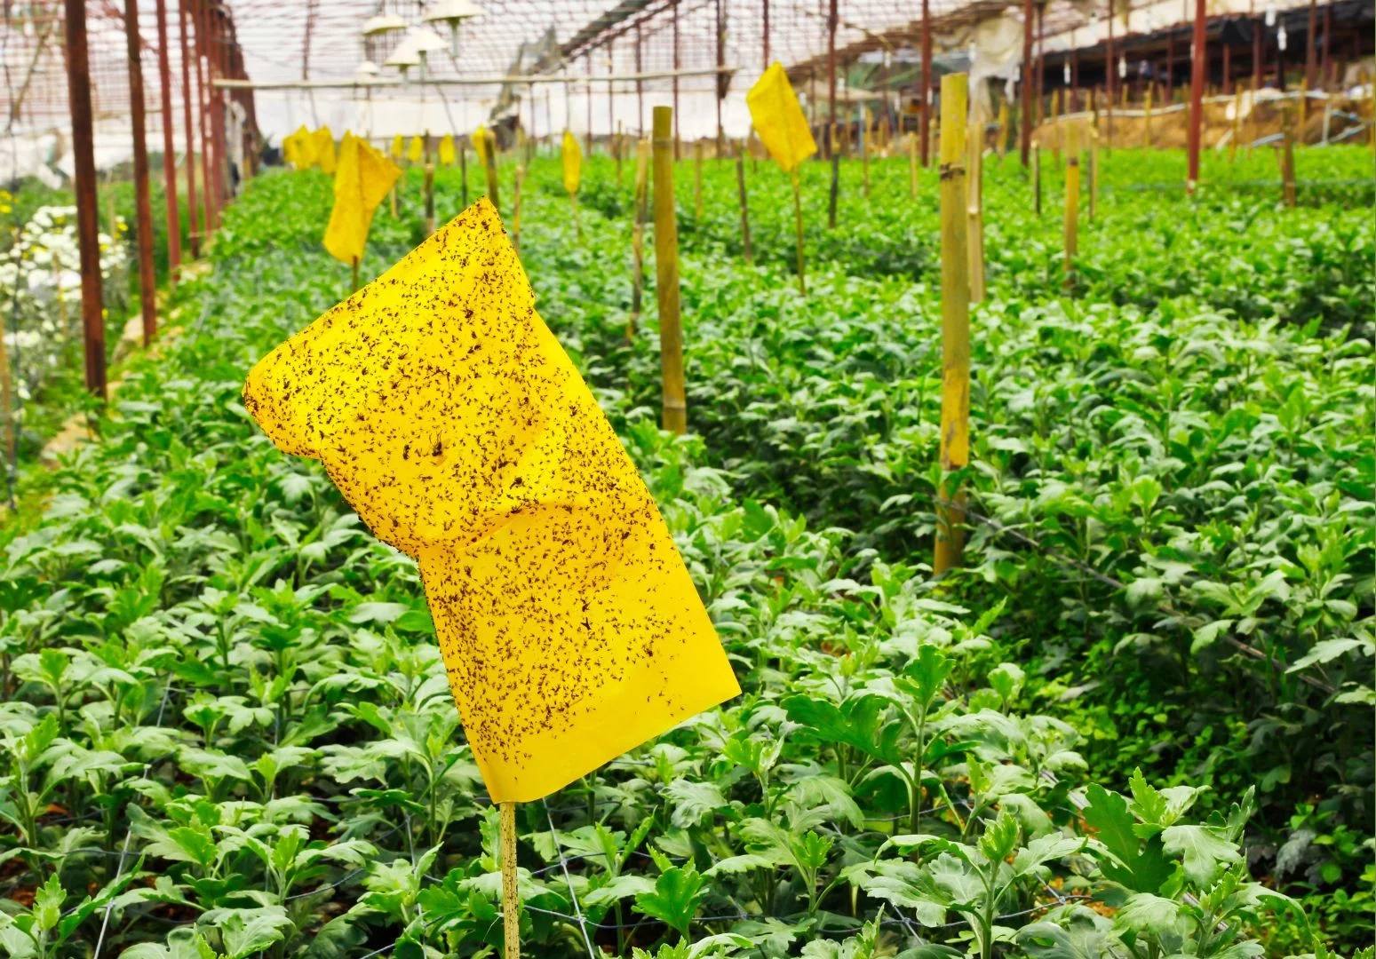
Integrated Pest Management practices

Slide 4
Problem Statement
Despite the benefits of IPM, its adoption among smallholder tea farmers in Kiambaa Sub County remains low.
Heavy reliance on chemical pesticides raises concerns about environmental sustainability and human health risks due to pesticide residues on produce after harvest.
Pesticide residues may lead to exports not fully meeting international market standards due to some non-tariff barriers like; sanitary and phytosanitary measures.
- There is limited research on the socio-economic and institutional factors influencing IPM adoption.
This study seeks to bridge this gap by analyzing the key determinants affecting IPM uptake among tea farmers.

Slide 5
Objectives of the Study
General objective: To investigate the level of adoption of IPM practices and the determinants of farmers’ decisions on IPM innovation adoption among smallholder farmers in Kiambaa Sub County.
Specific Objectives:
1. To identify the existing factors affecting the adoption of IPM practices among smallholder tea farmers.
2. To examine the effect of institutional support mechanisms and socio-economic characteristics on the level of IPM adoption.

Slide 6
Research Hypotheses
iThere are no existing factors significantly affecting the adoption of IPM practices.
ii There is no significant relationship between institutional support, socio-economic characteristics, and the level of IPM adoption.

Slide 7
Conceptual Framework
    .
Independent Variables:
Access to extension services
Farmer cooperative membership
Access to credit
Knowledge and awareness
Socio-economic factors: Farm income.
Dependent Variable:
The adoption of integrated pest management practices
Government policies

Slide 8
Methodology
Research design: A mixed-method approach combining both qualitative and quantitative analysis
Study area: The study was conducted in Kiambaa Sub County, Kiambu County characterized by small holder farmers.
Sample size: 232 smallholder tea farmers selected using stratified random sampling. Target population was smallholder tea farmers.
Data collection methods: Structured questionnaires administered to smallholder tea farmers.
Data analysis: Descriptive statistics to summarize the respondents’ demographic characteristics and Tobit regression to evaluate factors influencing IPM adoption because of its ability to handle censored data. Adoption was censored to account for non-adopters.
Statistical software: SPSS AND STATA

Slide 9
Results
 | Frequency | Percent | Cumulative Percent
Age below 25 | 3 | 1.3 | 1.3
26-35 | 70 | 30.2 | 31.5
36-50 | 81 | 34.9 | 66.4
above 50 | 78 | 33.6 | 100.0
Total | 232 | 100.0
Gender Male | 129 | 55.6 | 55.6
Female | 103 | 44.4 | 100.0
Total | 232 | 100.0
Education
Tertiary | 87 | 37.5 | 37.5
Secondary | 91 | 39.2 | 76.7
Primary | 54 | 23.3 | 100.0
Total | 232 | 100.0
.
Variable | Coefficient | Std. Err. | t-value | P>/T/ | 95% Conf. Interval(lower bound) | 95% Conf. Interval(upper bound)
Awarenessofipm | 2.547192 | .3094957 | 8.23 | 0.000 | 1.93734 | 3.157044
Farmincome | .0000211 | 4.45e-06 | 4.74 | 0.000 | .0000123 | .0000298
creditaccess | .1196131 | .3226882 | 0.37 | 0.7111 | -.516234 | .7554603
cooperativemembership | .2233449 | .236045 | 0.95 | 0.345 | -.2417745 | .6884644
Extensionvisits | .4694133 | .1769983 | 2.65 | 0.009 | .1206435 | .8181831
Constant(_cons) | -5.806633 | .8941237 | -6.49 | 0.000 | -7.568476 | -4.044789

Slide 10
Key Findings
61.6% farmers have not adopted IPM., 32.2% have partially adopted IPM while only 5.2% have fully adopted IPM practices. This is in agreement with a study by (Sadique Rahman, 2020) on the determinants of adoption of IPM practices.
Objective 1
Significant factors:
Awareness of IPM coeff.2.5472 (P<0.0001)- Farmers with more knowledge are more likely to adopt.
Farm Income Coeff. 0.0000211(p < 0.001) → Higher-income farmers adopt IPM at a greater rate.
Frequency of Extension Visits Coeff.0.4694 (p = 0.009) → Regular interactions with extension officers increase adoption.
Non-significant factors:
Credit Access (p = 0.711) → Credit availability does not influence IPM adoption significantly. This is because the p> 0.05
Cooperative Membership (p = 0.345) → Being in a cooperative does not necessarily lead to higher adoption. The p> 0.05 shows that it is not significant.

Slide 11
Objective 2
Significant variables:
Awareness of IPM: Has a strong positive influence (coefficient=2.5472, p<0.0001). Higher awareness greatly increases IPM adoption. This implies the need educational campaigns and farmer sensitization.
Farmer income: Had a positive and significant effect (coefficient=0.0000211, p<0.001). Farmers with higher income were more likely to adopt IPM than those with low income. It indicates that income support can boost adoption.
Extension visits: Had a positive and significant effect (coefficient=0.4694, p<0.009). More frequent visits and extension services would increase likelihood of adoption. This finding highlights the importance of active and regular farmer outreach.
Non-significant variables:
Access to credit: (coefficient=0.1196, p=0.711). Credit alone does not lead to higher adoption. Credit must be targeted towards IPM investment and supported with training.
Cooperative membership: (coefficient=0.2233, p=0.345). Membership alone does not affect adoption. Cooperatives may need to focus more on IPM training and awareness in order to raise the adoption levels of IPM practices.

Slide 12
Hypothesis Testing
:
Variable | p-value | Decision
Awareness of IPM | 0.000 | Reject H₀ – significant
Farm Income | 0.000 | Reject H₀ – significant
Frequency of Extension | 0.009 | Reject H₀ – significant
Credit Access | 0.711 | Fail to reject H₀ – not significant
Cooperative Membership | 0.345 | Fail to reject H₀ – not significant
Awareness, farm income and extension services are statistically significant (p<0.05) we reject the first null hypothesis. There are factors significantly affecting IPM adoption.
Some institutional factors(extension visits) and socio-economic factors(income & awareness) are significant therefore we reject the second null hypothesis. There is a significant relationship between institutional support, socioeconomic characteristics and IPM adoption.

Slide 13
Discussion
Awareness of IPM has the strongest influence on adoption, highlighting the need for farmer education programs.
Farm income significantly affects adoption, indicating that wealthier farmers are more willing to implement IPM.
Extension visits play a crucial role in adoption, emphasizing the importance of continuous farmer support and training.
Access to credit and cooperative membership were not significant, suggesting that financial incentives alone may not drive IPM adoption. Farmers may not be willing to risk investing their money from credit facilities on new agricultural technologies. They often tend to use funds acquired from credit for other farm inputs and expenses or even their household expenses. This suggests that strategies to improve access to credit should go hand in hand with spreading awareness and benefits of IPM practices to farmers through methods such as extension, demonstrations etc.

Slide 14
Conclusion
Awareness, extension services, and farm income are key determinants of IPM adoption.
Credit access and cooperative membership do not significantly impact adoption levels.
More efforts are needed to promote awareness, strengthen extension services, and support lower-income farmers.
Adoption of IPM is Still Low: 61.6% of farmers have not adopted IPM, while only 5.2% have fully adopted it.
Limited awareness and financial constraints contribute to the low adoption rates.
Addressing awareness and extension gaps can significantly improve sustainable tea farming practices in Kiambaa Sub-County.

Slide 15
Recommendations
1. Enhance Extension Services :Increase training and outreach programs to improve farmer knowledge of IPM.
2. Raise Awareness: Conduct workshops, demonstrations, and information campaigns to promote IPM adoption.
3. Improve Access to Credit: Develop tailored financial support programs that encourage investment in IPM.
4. Strengthen Farmer Cooperatives: Encourage cooperatives to integrate IPM training and resource-sharing initiatives.
5. Government Support: Implement policies and incentives to promote sustainable pest management strategies.

